Slide 1

FHIRPath
Patrick W. Jamieson, M.D.
Technical Product Manager
Russ Leftwich, M.D.
Senior Clinical Advisor, Interoperability

Slide 2

Objectives
Understand the Fundamentals of FHIRPath
Develop and Apply FHIR Expressions
Evaluate Requirement Constraints with FHIRPath
Notes:
Understand the Fundamentals of FHIRPath – Learn how FHIRPath is used as a specialized expression language to query, filter, and transform FHIR resources efficiently.
Develop and Apply FHIR Expressions – Gain proficiency in constructing and utilizing FHIR Expressions, including operators and functions, to navigate and manipulate FHIR data.
Evaluate Requirement Constraints with FHIRPath – Explore how FHIRPath is used to define and enforce validation rules (invariants) for FHIR resources, ensuring data integrity and compliance.

Slide 3
FHIRPath: Querying & Transforming FHIR Resources
What is FHIRPath?
A powerful, domain-specific expression language
Core Functions:
Querying, filtering, and transforming FHIR data
Key Advantages:
Simplifies resource navigation and data extraction
Enhances clinical decision support and data validation
Real-World Impact:
Drives efficient data processing in healthcare interoperability
Notes:
FHIRPath is a specialized expression language designed specifically for the FHIR ecosystem. It allows developers and implementers to query, filter, and transform FHIR resources in a straightforward and effective manner. At its core, FHIRPath provides a set of syntax rules and functions that enable users to navigate through the complex hierarchies of FHIR resources. This capability is essential because FHIR resources often contain nested and interrelated data that needs to be accessed or manipulated.
One of the primary roles of FHIRPath is in querying. With FHIRPath, you can extract specific pieces of information from a FHIR resource without having to process the entire data structure. This selective querying simplifies the process of data retrieval, making it much more efficient. For example, if you need to retrieve a patient’s allergies or medication history, FHIRPath expressions can be crafted to pinpoint exactly that information.
In addition to querying, FHIRPath also plays a significant role in transforming data. It enables the manipulation of data through built-in functions that can perform operations like filtering, counting, or aggregating values. This transformation capability is crucial in various scenarios, such as clinical decision support systems, where data needs to be processed and analyzed quickly to provide real-time insights.
Ultimately, FHIRPath enhances both the efficiency and accuracy of working with FHIR resources, making it an indispensable tool in healthcare interoperability. By streamlining the process of accessing and transforming data, FHIRPath supports the development of robust, data-driven healthcare applications.

Slide 4
FHIRPath Features
Graph-traversal: FHIRPath is a graph-traversal language; authors can clearly and concisely express graph traversal on hierarchical information models
Fluent: FHIRPath has a syntax based on the Fluent Interface pattern
Collection-centric: FHIRPath deals with all values as collections, allowing it to easily deal with information models with repeating elements.
Platform-independent: FHIRPath is a conceptual and logical specification that can be implemented in any platform.

Slide 5
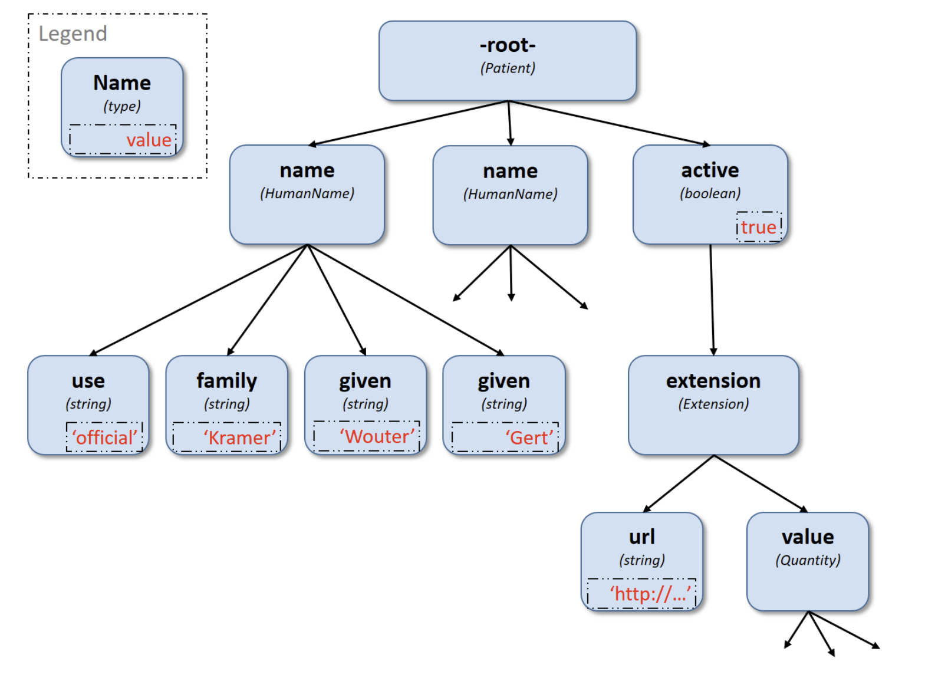
Navigation Model
https://hl7.org/fhirpath/#background

Slide 6
Collections
Ordered - The order of items in the collection is important and is preserved through operations as much as possible
Non-Unique - Duplicate elements are allowed within a collection. Some operations and functions, such as distinct() and the union operator | produce collections of unique elements, but in general, duplicate elements are allowed.
Indexed - Each item in a collection can be addressed by its index, in each ordinal position within the collection (e.g. a[2]).
Unless specified otherwise by the underlying Object Model, the first item in a collection has index 0.
Countable - The number of items in a given collection can always be determined using the count() function
https://hl7.org/fhirpath/#background

Slide 7
FHIR Expressions - Domain-specific language for FHIR data manipulation
Core Components
Identifiers, literals, functions, and operators
Expression Structure
Syntax rules for navigating and extracting data
Purpose
Simplify querying and transforming FHIR resources
Notes:
FHIR Expressions form the backbone of querying and transforming data within the FHIR ecosystem. In this slide, we introduce FHIR Expressions as a domain-specific language that enables precise data manipulation. Essentially, these expressions provide a structured way to navigate the intricate hierarchies of FHIR resources. The key components include identifiers, which point to elements within a resource; literals, which are constant values; functions, which perform specific operations like filtering or aggregation; and operators, which allow you to perform arithmetic or logical comparisons.
The structure of a FHIR Expression is designed to be intuitive, following defined syntax rules that help in pinpointing exactly the data you need. For instance, when you want to extract patient details or medication records, FHIR Expressions allow you to write concise expressions that traverse nested elements without the need to parse the entire resource manually. This capability not only simplifies the querying process but also enhances efficiency, particularly in complex scenarios like clinical decision support and data validation.
Understanding these basic building blocks is crucial. By mastering identifiers, literals, functions, and operators, you set a strong foundation for developing more advanced expressions. As you progress through this lesson, you’ll see how these components work together seamlessly to drive interoperability and support robust data-driven applications in healthcare.

Slide 8
Building FHIR Expressions – Operators
Basic Operators
Arithmetic, logical, and comparison operators
Common Functions
count(), exists(), is(), etc.
Combining Expressions
Nesting functions and operators
Notes:
FHIR Expressions leverage a variety of basic operators such as arithmetic operators for calculations, logical operators to combine conditions, and comparison operators to evaluate values. For example, you might use comparison operators to check if a patient's age is above a certain threshold or logical operators to ensure multiple conditions are met simultaneously.
In addition to operators, FHIR Expressions include a suite of functions like count(), exists(), and is(). These functions allow you to perform common tasks such as counting elements in an array, verifying the presence of a value, or testing data types. A practical example could be using the count() function to determine the number of medication entries in a patient record, or using exists() to confirm that a critical data field is populated.
Combining these functions and operators enables the creation of complex expressions that can filter, validate, and transform FHIR resources dynamically. Best practices in building these expressions include ensuring the syntax is clear and readable, which aids in maintenance and debugging. It’s also important to consider performance; well-structured expressions reduce processing overhead and lead to more efficient applications.

Slide 9
Basic FHIR Expression Examples
Extracting a Patient’s Given Name
Expression: Patient.name.given
Example Use: Retrieve a patient’s first name from their record for a personalized greeting in a patient portal.
Checking for the Existence of a Birth Date
Expression: Patient.birthDate.exists()
Example Use: Validate that the birth date field is populated before scheduling age-dependent clinical procedures.
Filtering by Gender
Expression: Patient.gender = 'female’
Example Use: Retrieve records for female patients to support a study on gender-specific treatment outcomes.
Retrieving Medication Dosage
Expression: MedicationRequest.dosageInstruction.doseQuantity
Example Use: Extract dosage instructions from a medication request to verify correct administration in clinical settings.

Slide 10
FHIRPath and Requirement Constraints
Requirement constraints—often called invariants—are rules that must be met for a resource or data element to be considered valid against the specification (or a specific profile). These constraints can cover anything from checking whether mandatory elements are present to ensuring that certain elements follow a particular rule or relationship
Example: “If status is ‘completed’, then completionDate must be present”.

Slide 11
Requirement Constraints (Invariants)
Constraints can apply at various levels:
Resource-level: e.g., a Patient resource must have at least one identifier.
Element-level: e.g., if an element is present, then some other element must also be present.
Profile-level: profiles (which define additional rules on top of FHIR resources) may add further constraints on cardinalities, value sets, or conditional logic.
Examples
If a Condition resource’s verificationStatus is set to confirmed, then certain additional data may be required.
If deceasedBoolean is true in the Patient resource, then deceasedDateTime cannot be present.
If an Observation has a valueQuantity, then it must have a unit or a code to specify what that quantity means.

Slide 12
Why FHIRPath Is Helpful for Evaluating Constraints
Ease of Navigating FHIR Resources
FHIR resources are structured and can be nested (e.g., Observation.subject.reference or Observation.component.valueQuantity).
FHIRPath provides a concise, XPath-like syntax for traversing these elements.
Example of a simple FHIRPath expression: Patient.deceased.exists() implies Patient.deceasedDateTime.empty().
Support for Common Operations
FHIRPath supports operations like exists(), empty(), = (equality), <, > (comparisons), and logical connectors (and, or, xor, implies).
This covers most logical checks needed to express constraints.

Slide 13
Why FHIRPath Is Helpful for Evaluating Constraints
Tooling and Automation
Many FHIR validators and implementation libraries (including the official FHIR Validator) understand FHIRPath and can automatically evaluate these expressions.
This allows constraints to be embedded in resource definitions or StructureDefinitions/Profiles and automatically checked by conformance tools—no extra custom parsing is required.
Reusability and Consistency
Once constraints are defined in FHIRPath, they can be reused across different FHIR profiles and implementations.
By standardizing on a single expression language (FHIRPath), the community avoids fragmentation with multiple or proprietary rule syntaxes.

Slide 14

FHIRPath Demo
This Photo by Unknown Author is licensed under CC BY-NC-ND

Slide 15
Want to Follow Along?
Open a terminal in VS Code
git clone https://github.com/pjamiesointersystems/fhirlesson7.git
We will only be using FHIRpath1.pyynb
Click on the file to open the Juypter Notebook, assuming you have Juypter installed correctly
Click the button at the top “Clear All Outputs”

Slide 16
Common Pitfalls and Error Scenarios
Missing Elements: Null vs. empty collections, optional vs. required fields.
Unexpected Data Types: Attempting to compare a multi-value collection directly to a scalar; type mismatches.
Collections vs. Singletons: Understanding how .exists(), .first(), or .where(...) can manage multiple items.
Real-World Examples:
Direct comparison of multi-value (component.valueQuantity.value > 70).
Checking deceased[x] type incorrectly.
Notes:
One of the biggest challenges developers face when working with FHIRPath is handling missing or unexpected data. In healthcare, data can be inconsistent—sometimes an element is optional, sometimes required, and sometimes it’s simply not present at all. If an expression tries to access properties of an element that doesn’t exist, it can lead to runtime errors or empty results that you might not anticipate.
Another common pitfall is dealing with unexpected data types. FHIR frequently uses “[x]” choice elements—like value[x]—which can be valueQuantity, valueCodeableConcept, or any other type. If you assume it’s always a Quantity and attempt a numerical comparison, you could trigger an error if it’s actually a CodeableConcept or if it’s missing.
The next issue often arises when you mistakenly treat collections as singletons. For instance, an Observation may have multiple component elements. Trying to compare component.valueQuantity.value directly to a single integer can break your logic if there are multiple values—one or more might be empty or of a different type. Recognizing when you have a collection and using functions like .exists(), .first(), or .where(...) is crucial to ensure your expressions behave correctly.
Lastly, it’s common to overlook edge cases in real-world data. For example, an Observation might include both systolic and diastolic components but also a top-level valueQuantity. Or Patient.deceased[x] might be a boolean in one record and a dateTime in another. Anticipating these variations—and testing them—keeps your FHIRPath expressions robust, prevents unexpected failures, and helps maintain reliable, high-quality data processing.

Slide 17

Thank you.

